Slide 1
2024 Presidential Nomination Primary Election Judge Training

Slide 2
Agenda
Key Dates & Points
Presidential Nomination Primary Ballots
Voting on Election Day
Mail Balloting
Absentee Balloting
Post Election & Canvassing

Slide 3
Abbreviations & Terms
AB: Absentee Balloting
ALM: Annual List Maintenance
EDR: Election Day Registration
ENR: Election Night Reporting
ERS: Election Reporting System
HCF: Health Care Facility Voting
MB: Mail Balloting
PNP: Presidential Nomination Primary
Counties: County election offices
Municipality: City, town or township

Slide 4
PNP Statute Language
First Tuesday in March of a presidential election year
Voters must declare political party preference to participate in voting
Voter’s party ballot choice is shared with the chair of chosen political party
Each party has its own ballot
Each party can choose to have “uncommitted” or “write-in” choices
Notes:
Unless otherwise agreed upon by party chairs by March 1st of the year before the PNP.

Slide 5
Key Dates - January
January 2024
1/5 - 3/4: PNP election judge training
1/19: PNP PAT testing may begin once ballots are proofed and approved
At least 3 days before equipment is used
1/19 - 2/20: PNP mail ballots sent
1/19 - 3/4: PNP AB voting

Slide 6
Key Dates - February
February 2024
2/13: February uniform special election date
2/13: PNP pre-registration deadline
2/15: AB & MB ballot processing may begin - at close of business
2/16: PNP direct balloting (alternative AB procedure) may begin
2/27: Agent “delivery and return” begins
2/27: PRECINCT CAUCUS MEETINGS

Slide 7
Key Dates - March
March 2024
3/2: AB voting from 9 a.m. to 3 p.m.
3/4: AB voting until 5 p.m.
3/5: PRESIDENTIAL NOMINATION PRIMARY DAY
3/7 - 3/8: PNP county canvassing period
3/12: March Town Elections date

Slide 8
Things to Keep in Mind
Elections Emergency Plans
Uncommitted and Write-ins
Data Privacy
Recording Ballot Choice

Slide 9
Ballots

Slide 10
Included Political Parties
Major Political Parties only (potential of 3 different ballots)
Legal Marijuana Now Party
Republican Party
Democratic Farmer Labor Party
Notes:
The Legal Marijuana Now Party did not have a PNP ballot in 2020.
May not have an answer as to party participation until January 2, 2024.

Slide 11
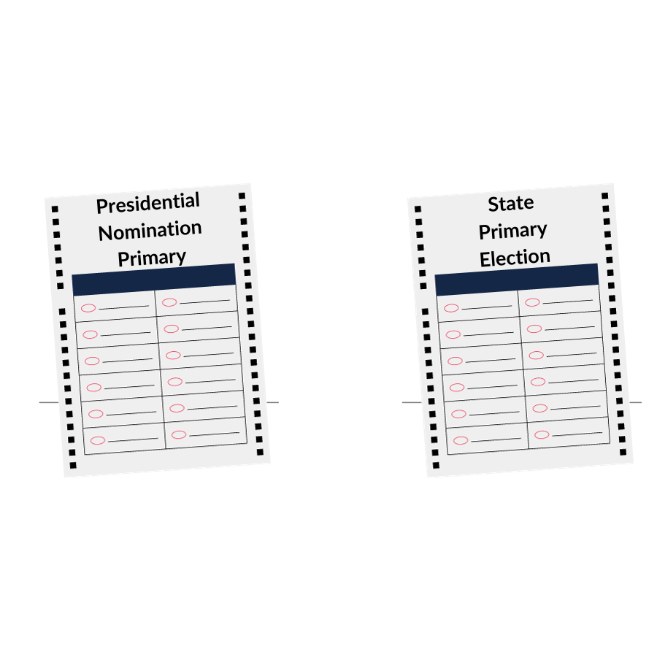
Presidential Nomination Primary Ballot vs. State Primary Ballot
General Rule – Except as provided by law, presidential nomination primary ballots shall be printed in the same manner as state primary ballots as far as practicable.
Notes:
Differences are noted in the next slides.

Slide 12
Example Ballot
Although the PNP ballot does look like a State Primary ballot, there are several differences.
Let’s take a closer look at an example ballot to review the layout of PNP ballots.

Slide 13
Example Ballot - Title
Title – Presidential Nomination Primary Ballot
Party Name
Date – March 5, 2024
Instructions Differences
Party Name at the top of the Column
President only listed
Uncommitted Option
Write-in Option
No instructions to vote on other side of Ballot

Slide 14
Example Ballot – Party Name
Title – Presidential Nomination Primary Ballot
Party Name
Date – March 5, 2024
Instructions Differences
Party Name at the top of the Column
President only listed
Uncommitted Option
Write-in Option
No instructions to vote on other side of Ballot

Slide 15
Example Ballot - Date
Title – Presidential Nomination Primary Ballot
Party Name
Date – March 5, 2024
Instructions Differences
Party Name at the top of the Column
President only listed
Uncommitted Option
Write-in Option
No instructions to vote on other side of Ballot

Slide 16
Example Ballot – Instructions
Title – Presidential Nomination Primary Ballot
Party Name
Date – March 5, 2024
Instructions Differences
Party Name at the top of the Column
President only listed
Uncommitted Option
Write-in Option
No instructions to vote on other side of Ballot
These ballot instructions are different from general and state primary election ballot instructions.

Slide 17
Example Ballot – Column Title
Title – Presidential Nomination Primary Ballot
Party Name
Date – March 5, 2024
Instructions Differences
Party Name at the top of the Column
President only listed
Uncommitted Option
Write-in Option
No instructions to vote on other side of Ballot

Slide 18
Example Ballot – Candidates
Title – Presidential Nomination Primary Ballot
Party Name
Date – March 5, 2024
Instructions Differences
Party Name at the top of the Column
President only listed
Uncommitted Option
Write-in Option
No instructions to vote on other side of Ballot
Only the name of the Presidential candidate is listed, no Vice-Presidential choices are included on this ballot.

Slide 19
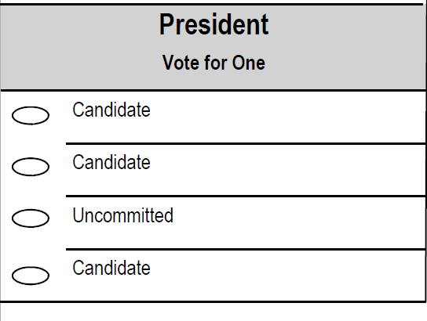
Example Ballot – Uncommitted
Title – Presidential Nomination Primary Ballot
Party Name
Date – March 5, 2024
Instructions Differences
Party Name at the top of the Column
President only listed
Uncommitted Option
Write-in Option
No instructions to vote on other side of Ballot
The “Uncommitted” option rotates position by precinct and is only included if the major party chair requests it.

Slide 20
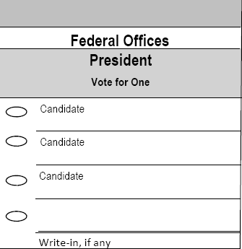
Example Ballot – Write-in
Title – Presidential Nomination Primary Ballot
Party Name
Date – March 5, 2024
Instructions Differences
Party Name at the top of the Column
President only listed
Uncommitted Option
Write-in Option
No instructions to vote on other side of Ballot
The “Write-in” option is always listed last and is only included if the major party chair requests it.

Slide 21
Example Ballot – One Sided Ballot
Title – Presidential Nomination Primary Ballot
Party Name
Date – March 5, 2024
Instructions Differences
Party Name at the top of the Column
President only listed
Uncommitted Option
Write-in Option
No instructions to vote on other side of Ballot

Slide 22
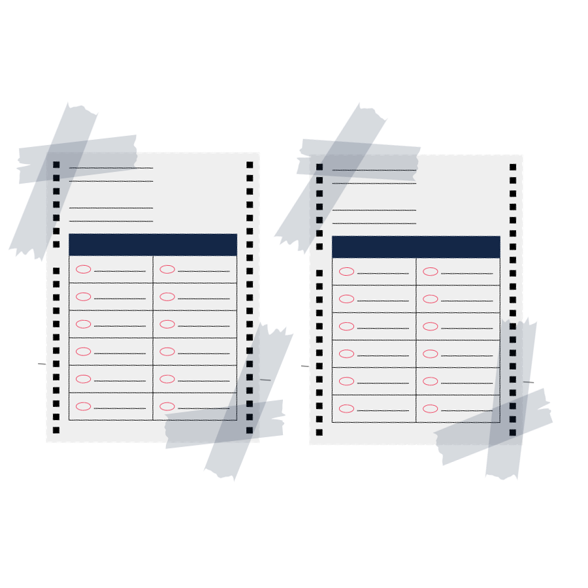
Sample Ballots – Required Placement
Post 2 sets of each party’s Sample Ballots in the Polling Place
Legal Marijuana Now Party
Republican Party
Democratic-Farmer-Labor Party
Ensure the sample ballots are accessible to those who might be in a wheelchair or lower to the ground

Slide 23
Sample Ballots - Questions
Refer voters to Sample Ballots if voters have questions about which ballot to choose
Make sure any sample ballots are secured to a surface to avoid confusing them for real ballots

Slide 24
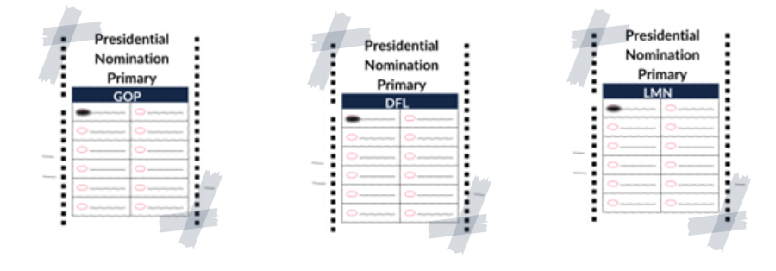
Sample Ballots – Party Preference
If you have a greeter judge, they can explain to voters that they will be asked to select a ballot based on party preference

Slide 25
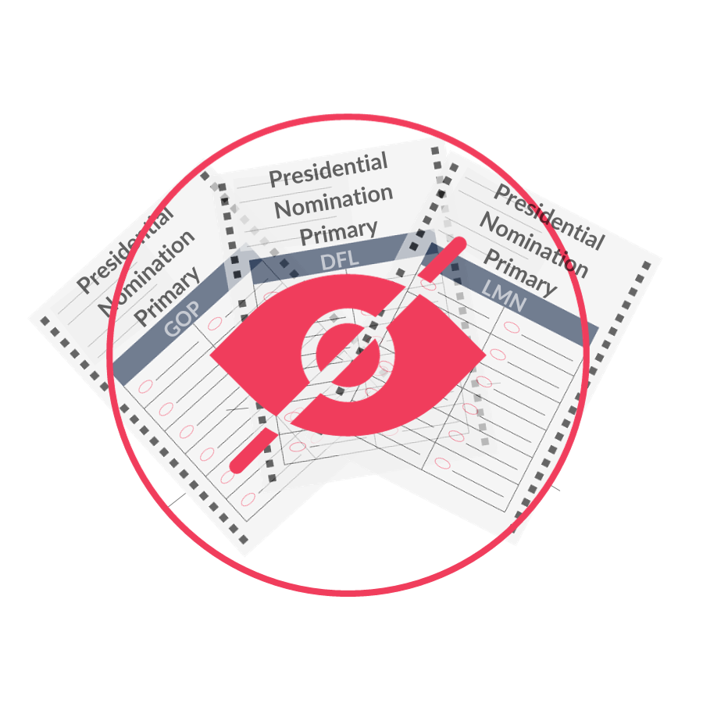
Voter Privacy
As an election judge you must keep a voter's party choice private. Do not announce or indicate party choice at any point.
Do not share voter party preference information with anyone inside or outside of the polling place.
Take steps to keep party choice private on paper rosters.

Slide 26
Voter Privacy – State Law
Because the major political party choice of a voter has been deemed private by state law (M.S. 207A.12(b))….
Willful disclosure (before, during & after Election Day) of a voter’s major political party ballot choice to anyone other than those authorized by law is a crime under M.S. 13.09; civil penalties may also be imposed upon the individual as well as the municipality under M.S. 13.08 and 13.085.

Slide 27
Voting on Election Day

Slide 28
Polling Place Setup Roster Signing & Privacy Protection
Provide a Private space
Cover roster information
Turn away rosters from voters when not in use
Keep voter receipts face down
Don’t vary by color or size

Slide 29
Election Judge Roles
Greeter Judge
Roster Judge
Registration Judge
Demonstration Judge
Ballot Judge
Head Judge
HCF Election Judge
A more detailed description is available in the PNP EJ Supplemental Guide

Slide 30
Election Judge Roles – Greeter Judge
Greeter Judge
Roster Judge
Registration Judge
Demonstration Judge
Ballot Judge
Head Judge
HCF Election Judge
Greeter Judge
Greets and guides voters while they enter polling location
Informs voter about party choice requirements
Frequently point to sample ballots
Directs most questions to informational posters or head judge
Frequently views parking lot for curbside voters

Slide 31
Election Judge Roles – Roster Judge
Greeter Judge
Roster Judge
Registration Judge
Demonstration Judge
Ballot Judge
Head Judge
HCF Election Judge
Roster Judge
Cover private information and party choice
Instruct voter to sign and mark party choice
Give voter receipt with party choice
Points to sample ballots if voters are unsure of party choice

Slide 32
Election Judge Roles – Registration Judge
Greeter Judge
Roster Judge
Registration Judge
Demonstration Judge
Ballot Judge
Head Judge
HCF Election Judge
Registration Judge
Registers unregistered voters
Refers voters to correct poll location*
For precincts with electronic rosters, the roster and registration judge roles may be combined
Notes:
If it is determined that the voter resides in a different precinct.

Slide 33
Election Judge Roles – Demonstration Judge
Greeter Judge
Roster Judge
Registration Judge
Demonstration Judge
Ballot Judge
Head Judge
HCF Election Judge
Demonstration Judge
Explain separate party ballots
Explain “Write-in” Choice if present on party’s ballot
Emphasize filling in target
Explain “Uncommitted” Choice if present on party’s ballot

Slide 34
Election Judge Roles – Ballot Judge
Greeter Judge
Roster Judge
Registration Judge
Demonstration Judge
Ballot Judge
Head Judge
HCF Election Judge
Ballot Judge
Ballot receipts private
Replacement ballots must be same party as spoiled ballots
Determine party of spoiled ballot before discarding

Slide 35
Election Judge Roles – Head Judge
Greeter Judge
Roster Judge
Registration Judge
Demonstration Judge
Ballot Judge
Head Judge
HCF Election Judge
Head Judge
Explaining party choice requirement
Working with voters who refuse to provide party choice
Reviews credentials of challengers, media, election administration representatives
May conduct challenge procedures

Slide 36
Election Judge Roles – HCF Election Judge
Greeter Judge
Roster Judge
Registration Judge
Demonstration Judge
Ballot Judge
Head Judge
HCF Election Judge
HCF Election Judge
Explaining party choice
Voters must make party choice on Absentee Ballot Application

Slide 37
Curbside Voting
Use PNP Voter Certificate
Voter required to indicate party choice
Deliver only ballot noted on certificate

Slide 38
Challengers
The only action a challenger may take is to contest a voter’s eligibility.
Suspicion is not a basis for making a challenge.
The challenger must personally know that the person is not eligible to vote for a specific reason.
During the PNP, a challenger cannot challenge a party choice or make lists of voters.

Slide 39
Complaints
Voters might want to complain about the PNP’s party choice requirement.
Offer another explanation that this is a legal requirement.
If they insist, offer the State Elections Law Complaint Form
Make sure paper copies are included with supplies

Slide 40
Mail
Balloting

Slide 41
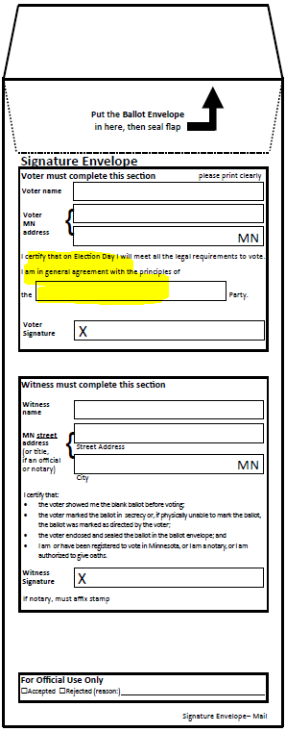
Mail Ballot Materials
Mail Ballot Materials
All major party ballots must be sent to each mail ballot voter – even replacement ballots
Different signature envelope
OSS Example based on current rules - Election Administrator Forms webpage
Encourage use of additional “return” envelope so that party choice is covered
Different Mail Ballot Voter Instructions
OSS example based on current rules – Election Administrator Forms webpage

Slide 42
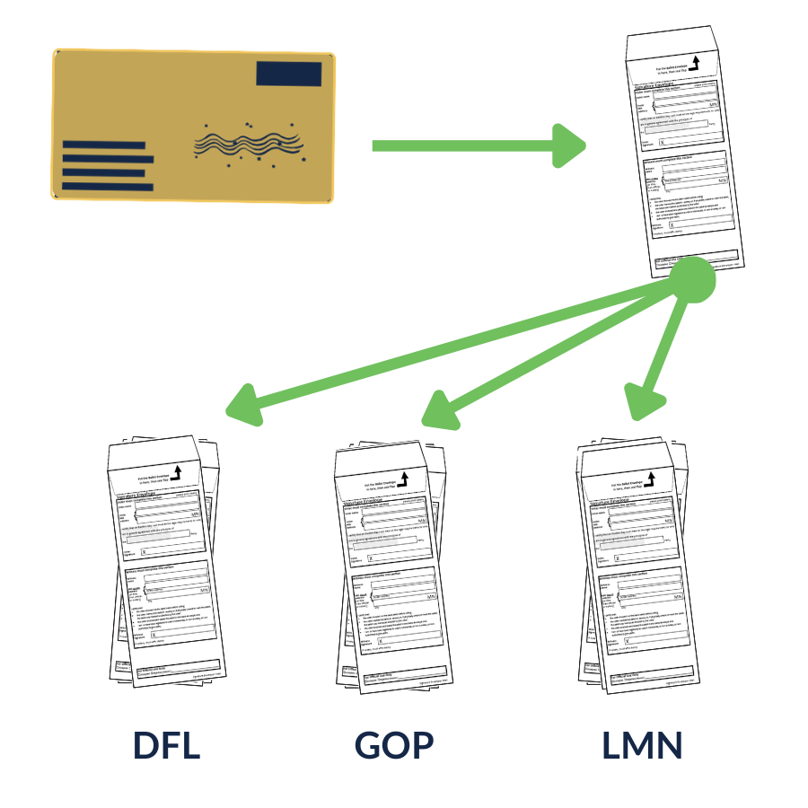
Mail Ballot Board – Intaking Mail Ballots
Processing Mail Ballots:
Separate signature envelopes from return envelopes (upon receipt)
Sort accepted mail ballot envelopes by major political party
Open secrecy envelope to remove contents, processing one party at a time
Notes:
This step is done when voted mail ballots are received and before acceptance/rejection by the ballot board.
Review the PNP Administration Guide for details surrounding accepting/rejecting PNP mail ballots.

Slide 43
Mail Ballot Board – Processing/Counting Mail Ballots
Processing accepted Mail Ballots:
Separate signature envelopes from return envelopes
Sort accepted mail ballot envelopes by major political party
Open secrecy envelope to remove contents, processing one party at a time

Slide 44
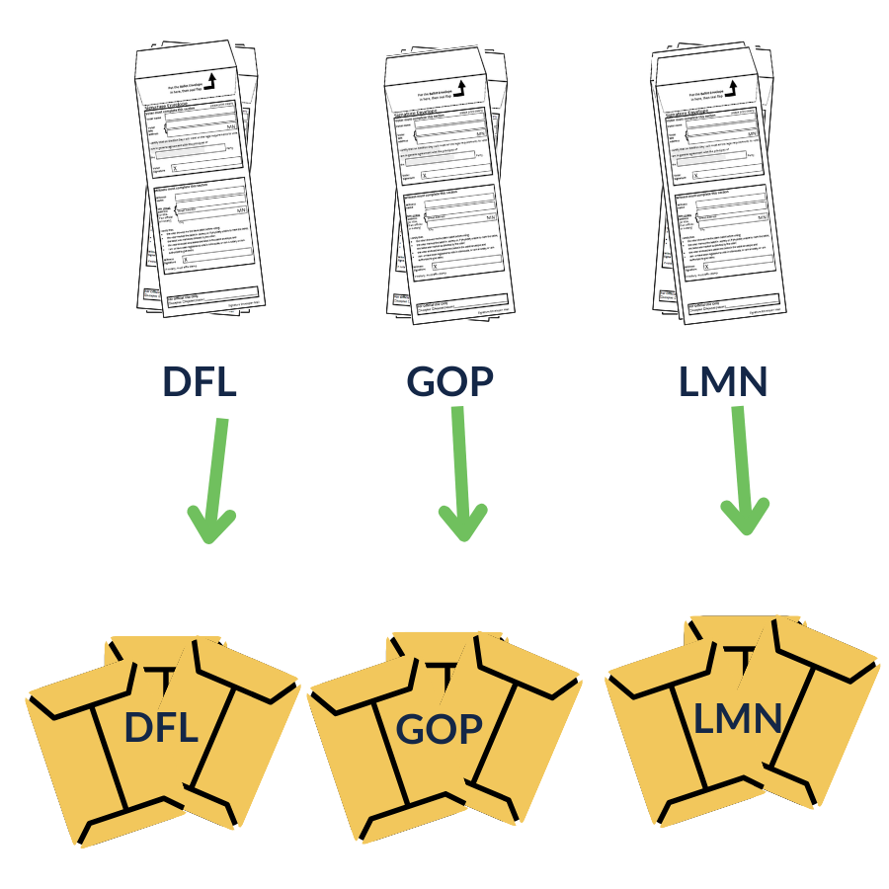
Mail Ballot Board – Processing Mail Ballots
Processing accepted Mail Ballots:
Separate signature envelopes from return envelopes
Sort accepted mail ballot envelopes by major political party
Open secrecy envelope to remove contents, processing one party at a time

Slide 45
Example: Processing Mail Ballots
For this example, we’ll process a pile of DFL envelopes.

Slide 46
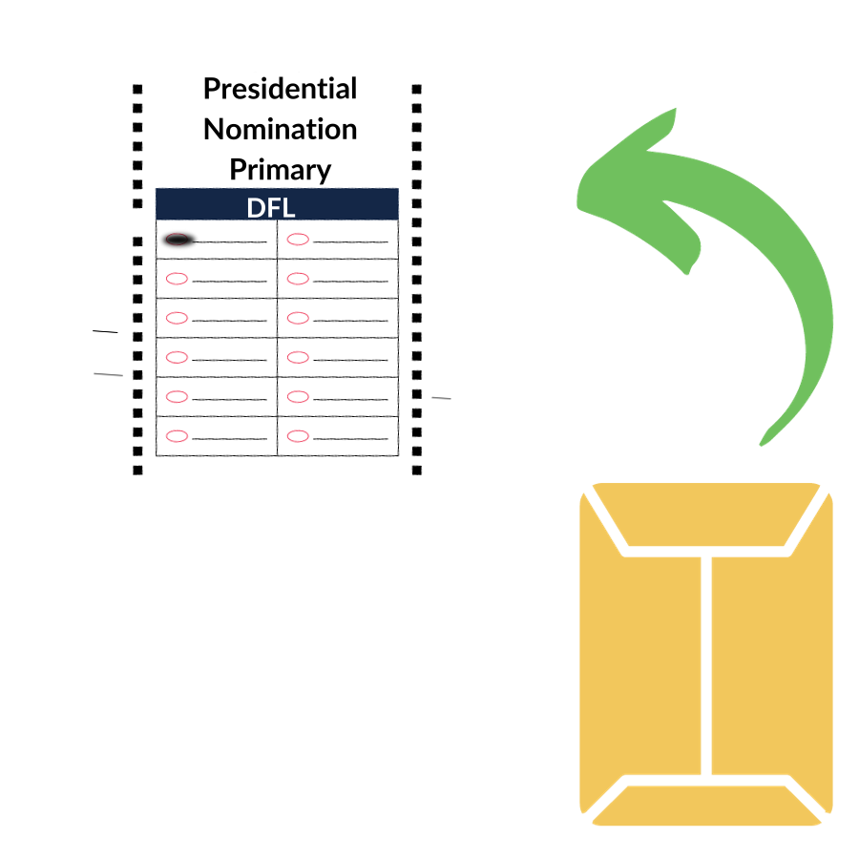
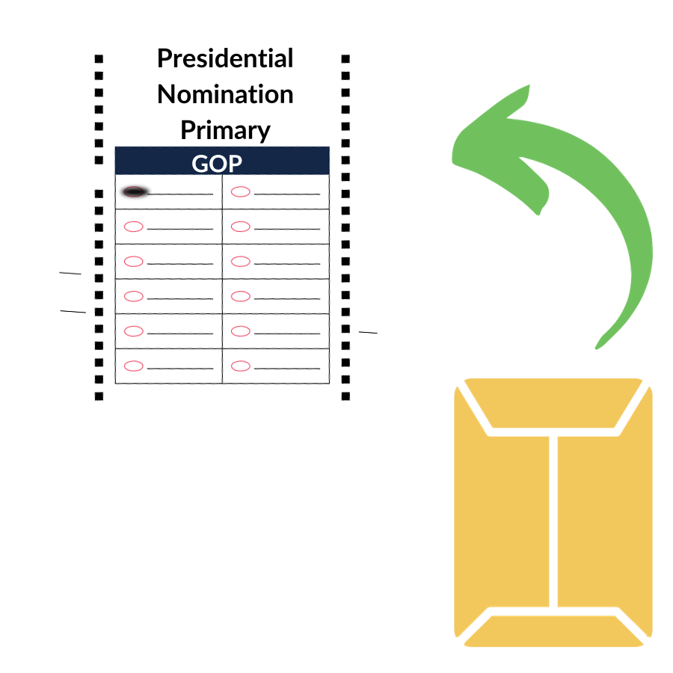
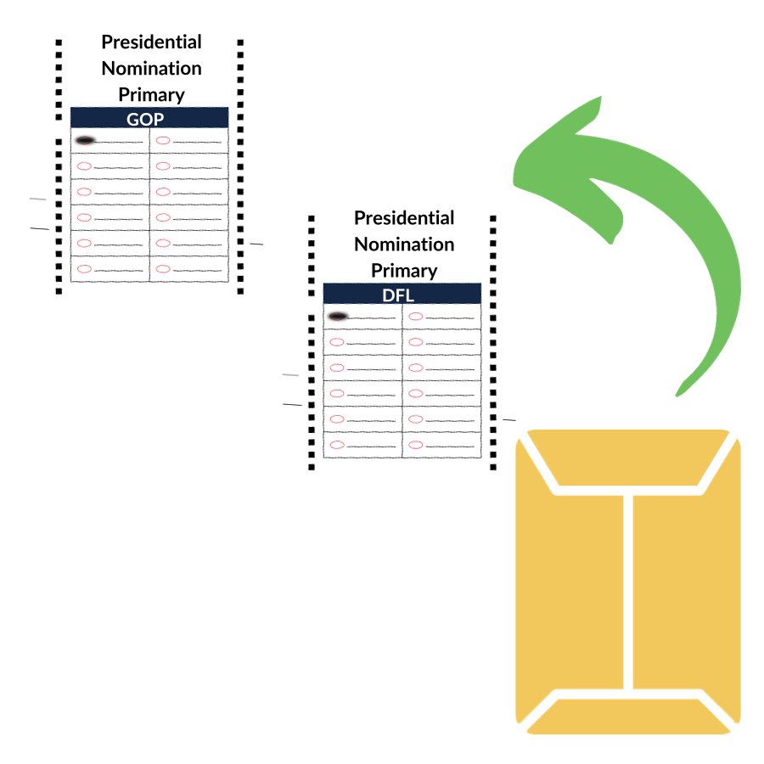
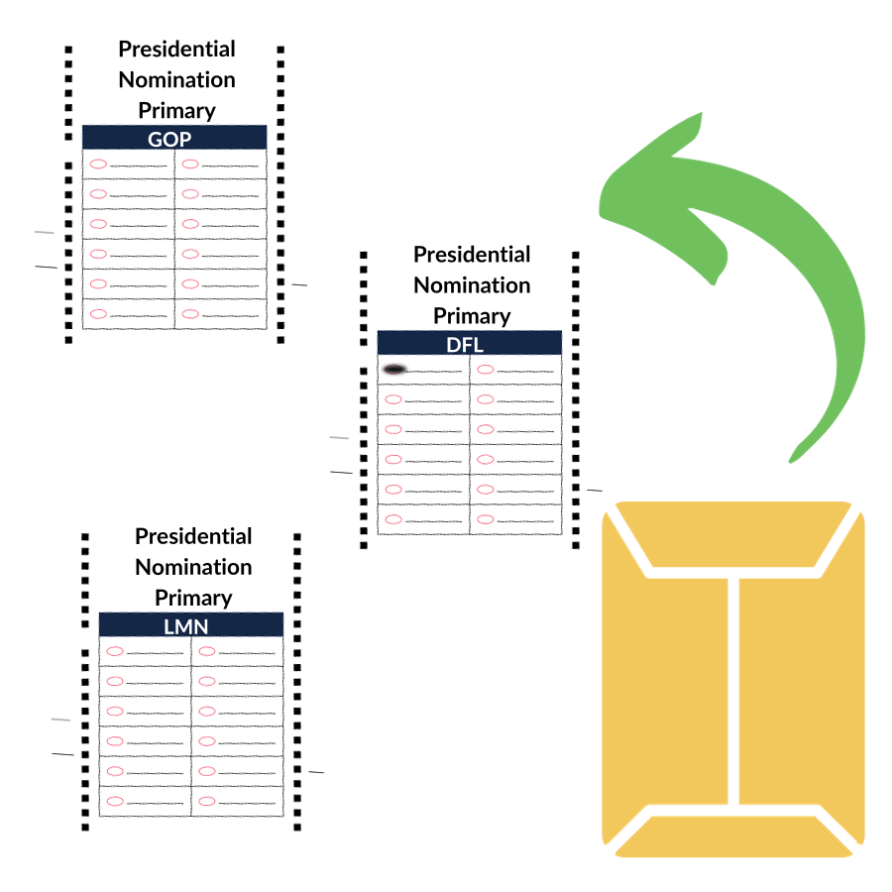
Processing Mail Ballots – Envelope 1
This envelope contains one marked DFL ballot.
Because the envelope contained the correct marked ballot, it can be counted.
1 Counted Ballot

Slide 47
Processing Mail Ballots – Envelope 2
This envelope contains one marked GOP ballot.
Because the envelope did not contain the correct marked ballot, it cannot be counted.
Note on the incident report: Ballot did not match indicated party.
1 Spoiled Ballot
1 Counted Ballot

Slide 48
Processing Mail Ballots – Envelope 3
This envelope contains one marked GOP ballot and one marked DFL ballot.
Because the envelope contained marked ballots from two parties, they cannot be counted.
Note on the incident report:
Envelope contained two marked ballots.
+1 ballot
2 Spoiled Ballots
1 Counted Ballot
1 Spoiled Ballot
Notes:
Because this envelope contains two ballots, a +1 must be noted to account for an extra ballot from the original count.

Slide 49
Processing Mail Ballots – Envelope 4
This envelope contains one marked DFL ballot and unmarked GOP and LMN ballots
Because the envelope contained a marked DFL ballot and two unmarked GOP and LMN ballots, the DFL ballot will be counted and the unmarked GOP and LMN ballots will be spoiled.
Note on the incident report: Envelope contained two unmarked ballots & +2 ballots
1 Counted Ballot
2 Spoiled Ballots
1 Counted Ballot
1 Spoiled Ballot
2 Spoiled Ballots
Notes:
Because this envelope contains three ballots, a +2 must be noted to account for two extra ballots from the original count.

Slide 50
Processing Mail Ballots - Summary
Now, we can see how many counted and how many spoiled ballots this pile of four DFL signature envelopes contained.
2 Spoiled Ballots
1 Counted Ballot
1 Counted Ballot
1 Spoiled Ballot
2 Spoiled Ballots

Slide 51
Example: Processing Mail Ballots
1 Spoiled Ballot
1 Counted Ballot
2 Spoiled Ballots
1 Counted Ballot
2 Spoiled Ballots
2 Counted Ballots
5 Spoiled Ballots

Slide 52
Processing and Logging Mail Ballots
2 Counted Ballots
5 Spoiled Ballots
Ballots are ready to be counted.
Each spoiled ballot is listed on the incident log.
Ballots must be kept in secure spoiled ballot storage.

Slide 53
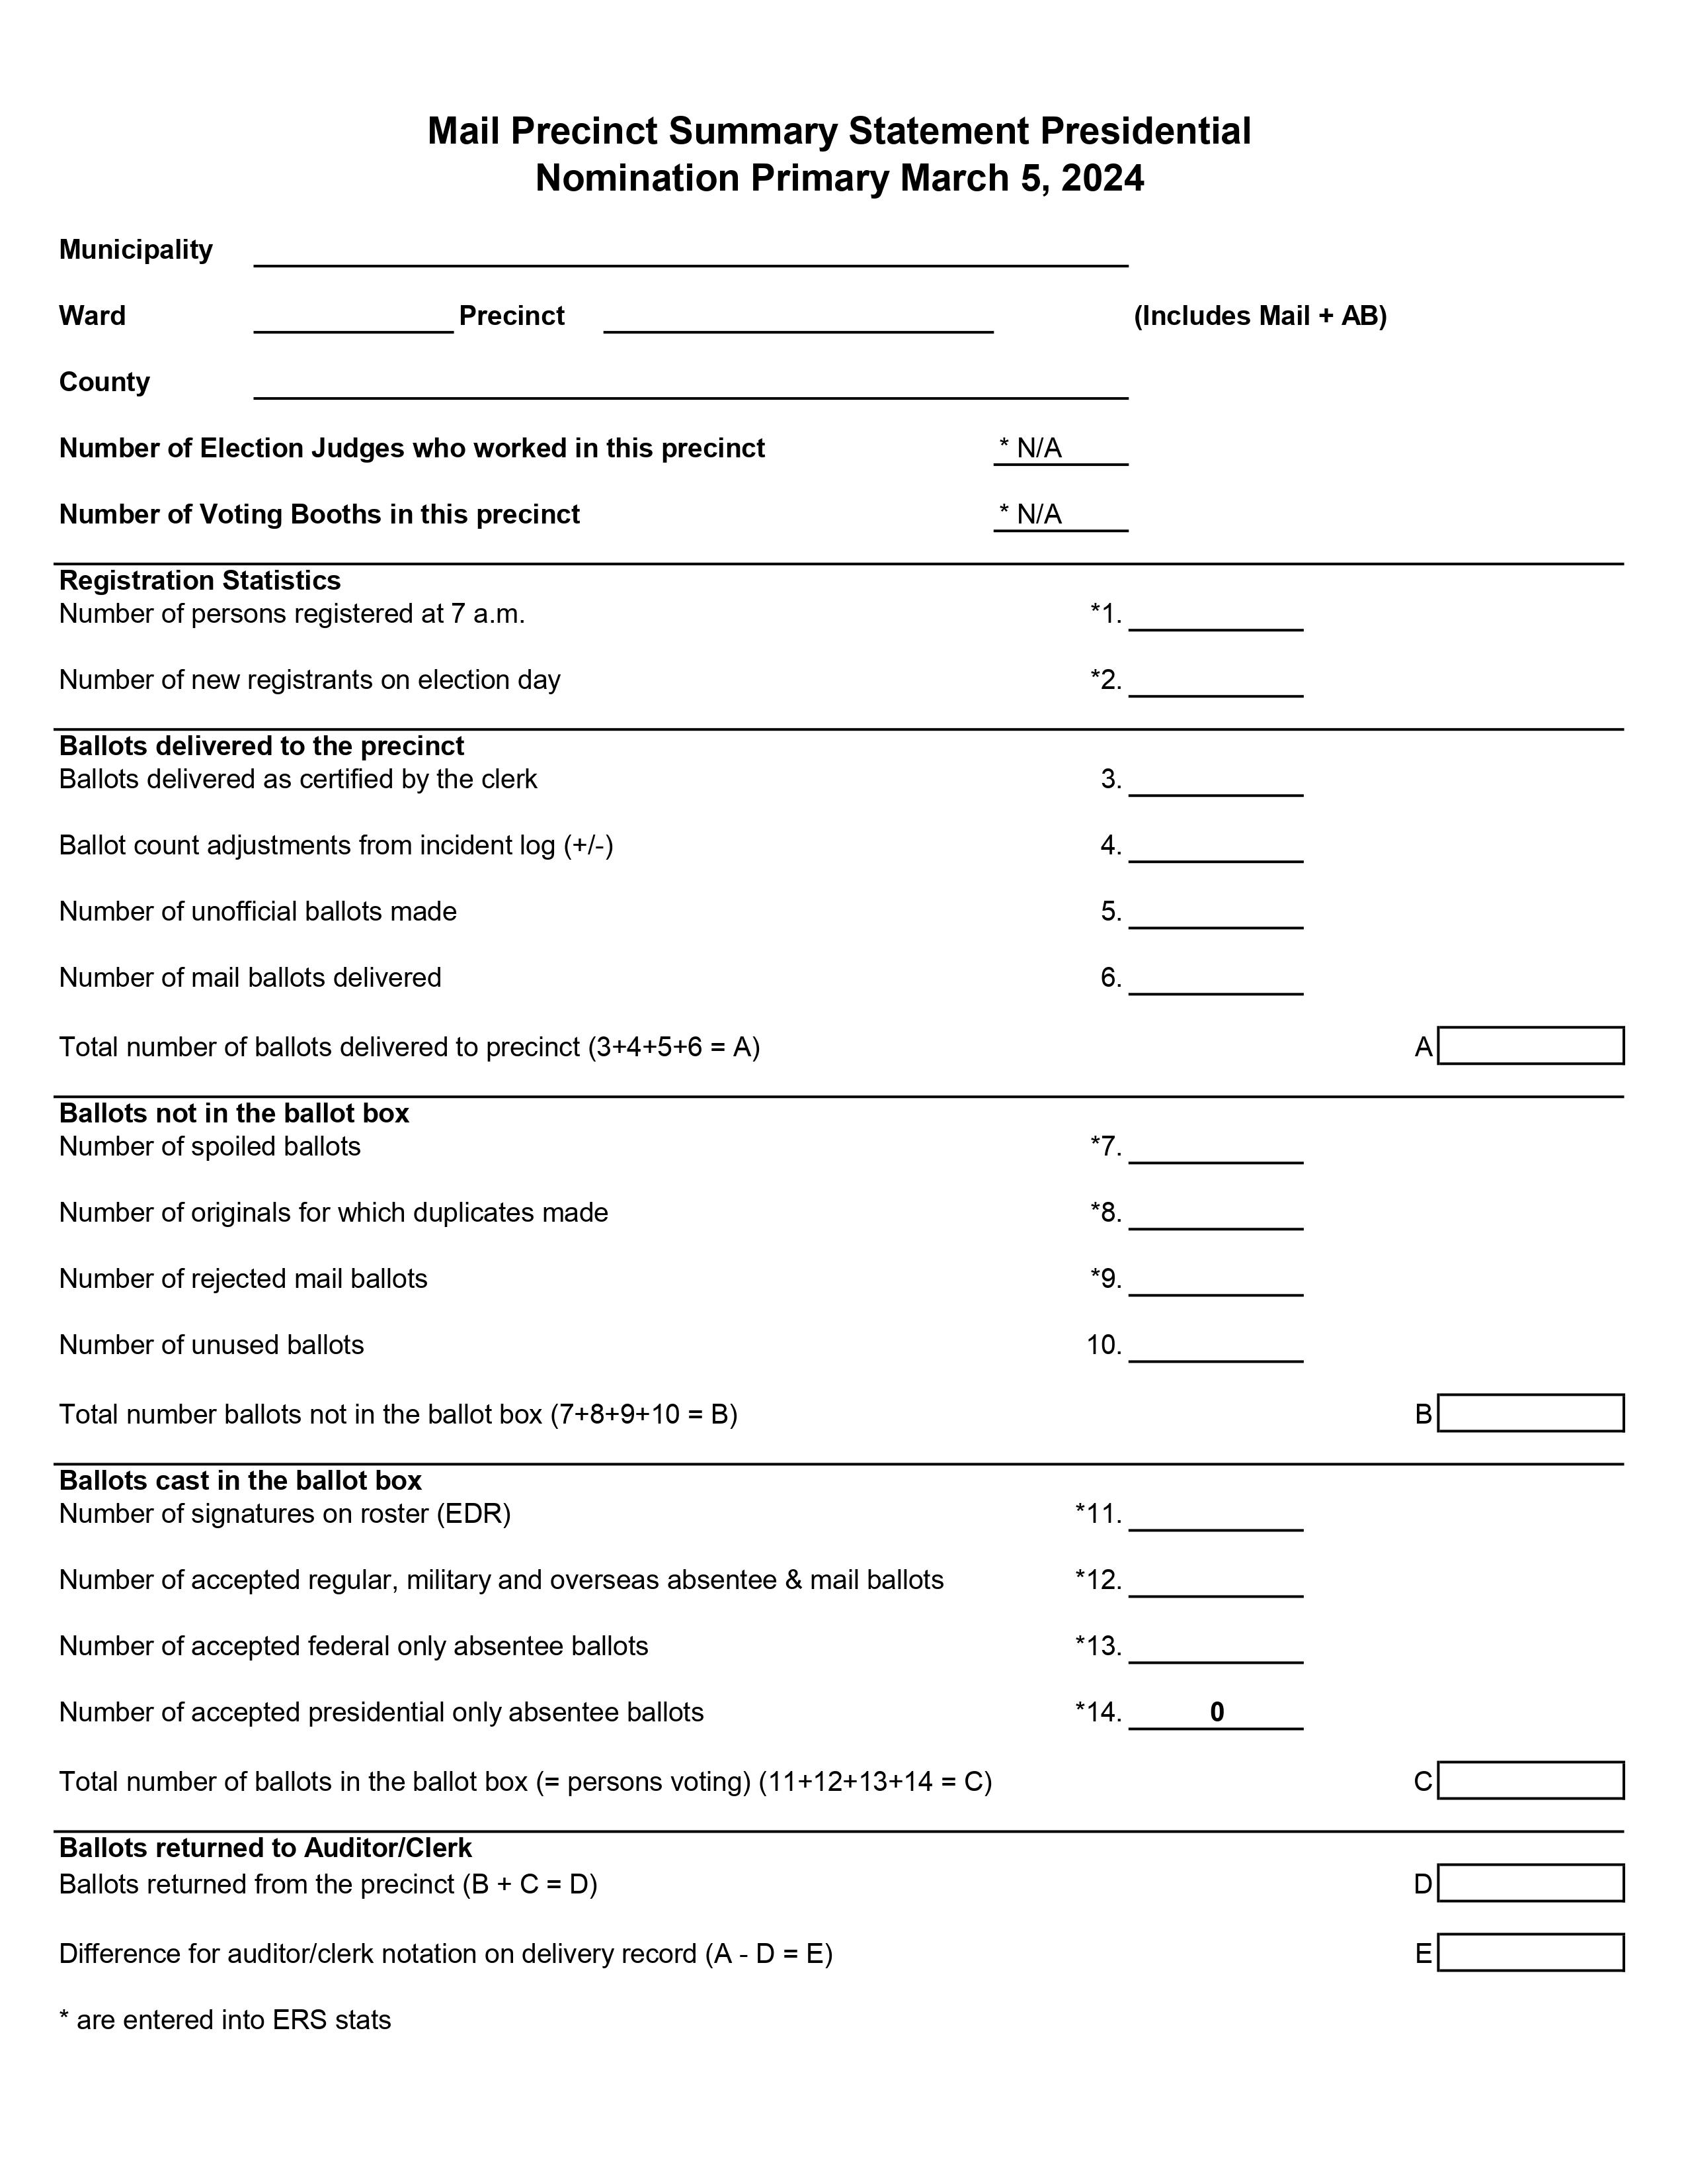
Processing Mail Ballots – Transferring Results
Next, we’ll record this data onto a Mail Precinct Summary Statement

Slide 54
Mail Precinct Summary Statement Example
+3
4
7
5
Item 12: Equals the number of signature envelopes which should equal the number of Accepted AB/MBs noted in a report.
Item C: Equals the number of ballots counted. This number should be equal to or less than Item 12.
5
4
2
7
0
Notes:
List the “extra” ballots noted in the incident log.

Slide 55
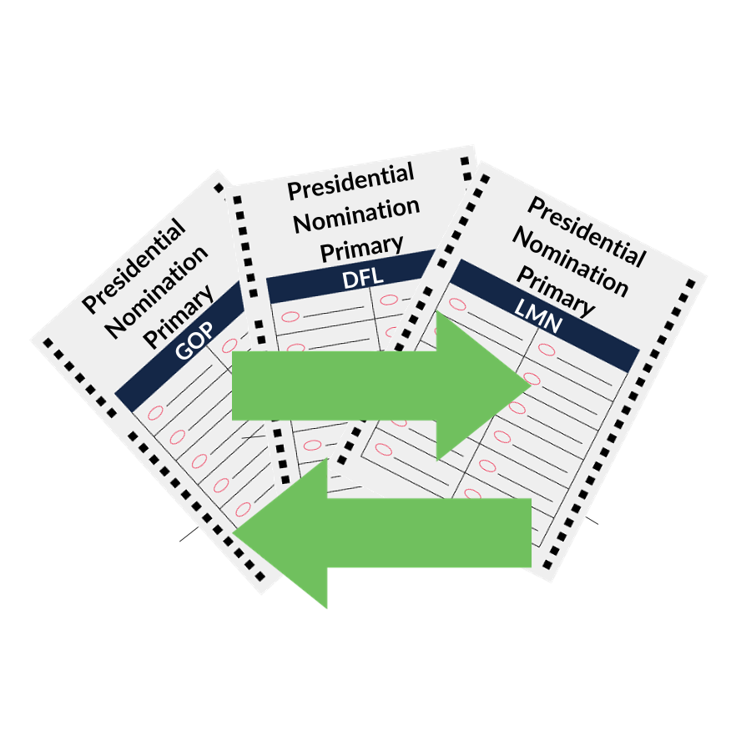
Mail Ballot Voters Changing Major Party Ballot Choice
Mail ballot voter may change their major party ballot choice through the end of business on the 19th day before the PNP
If a returned, voted MB has been received or accepted:
The received or accepted ballot is spoiled in SVRS
County sends replacement mail ballot packet that includes all major party ballots

Slide 56
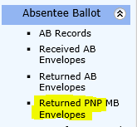
Mail Ballot Accepting & Rejecting
Additional rejection item of “party choice not valid”
Not listed
Not a major party
Cannot determine
Must use the PNP MB Envelopes module in SVRS for all returned PNP mail ballots

Slide 57
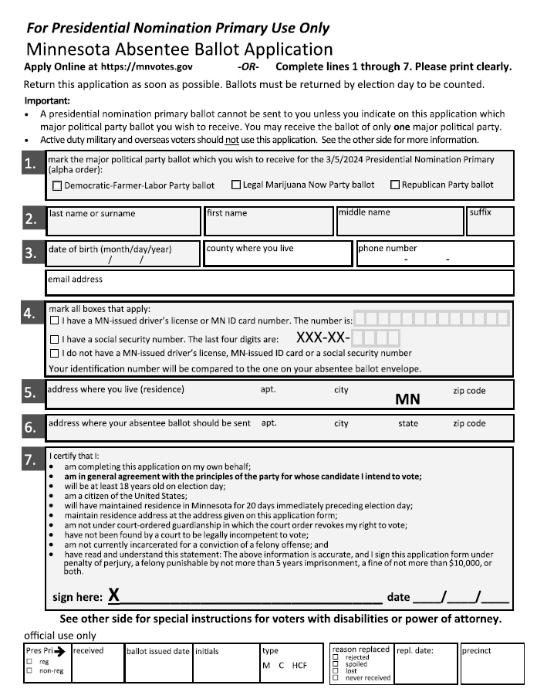
Absentee Voting

Slide 58
Absentee Ballot Request
Applications
Online & Paper UOCAVA – available now
Must note party choice on application
Specific PNP AB Application – must be used*
Online & Paper PNP AB applications
Available mid-November
Unlike other absentee ballot application forms, the application for the PNP requires the voter to select a party preference.
Notes:
The application will contain a listing of the three major parties. It will remain “as is” even if a major party does not participate.

Slide 59
Major Party Ballot Choice Change
Send voter a new absentee ballot based on the last application received
An AB voter may change their major party ballot choice through the end of business the 19th day before the Presidential Nominating Primary
AB voter must complete a new application
Voter may only be sent a replacement ballot of the major party choice that is on their latest application

Slide 60
Post Election & Canvassing

Slide 61
Post Election Process
Return of Materials
Secured Materials
Canvassing Process
Recounts
Contests
Access to PNP Information

Slide 62
Return of Materials
Same process as State Primary or State General Election
Election Judges must return within 24 hours
Materials should be returned the night of the election, unless in the case of an emergency or other agreement
All voted and spoiled ballots
Two sets of summary statements
Completed Voter Registration Applications
Voter Rosters
Voting Systems
Be prepared in case of weather issues

Slide 63
Secured Materials
Same process as State Primary or State General Election
Store by Precinct in safe, secure location
Keep “as delivered” until end of contest period
Strictly control access to these items during contest period

Slide 64
County Canvassing Board Meeting
General Rule – “Except as otherwise provided by law, the presidential nomination primary must be conducted, and the results canvassed and returned, in the manner provided by law for the state primary”
Meeting on either March 7 or March 8, 2024 (second or third day following the PNP)

Slide 65
State Canvassing Board Meeting
Meeting on Tuesday, March 12, 2024
Declares the results of the Presidential Nomination Primary.
Immediately after the declaration of results, the Sec. of State notifies the chair of each party of the results
The Results of the PNP must bind the election of delegates in each party

Slide 66
Recounts & Contests
There are no legal procedures outlined in Minnesota statutes for recounts or contests of the presidential nomination primary results
Attorney General 2019
It is best practice to retain election materials for the standard length of time, this will ensure documentation in case of any court challenges

Slide 67
Questions?
County Elections Office or Municipal Clerk Contact Information

